Slide 1
Phishing Attacks
Mariana ElMasry

Slide 2
Contents
01
02
03
What is Phishing?
Identifying Phishing Attacks
Protecting Against Phishing
04
05
06
Impact of Phishing Attacks
Phishing Trends and Statistics
Reporting and Responding to Phishing

Slide 3
What is Phishing?
01

Slide 4
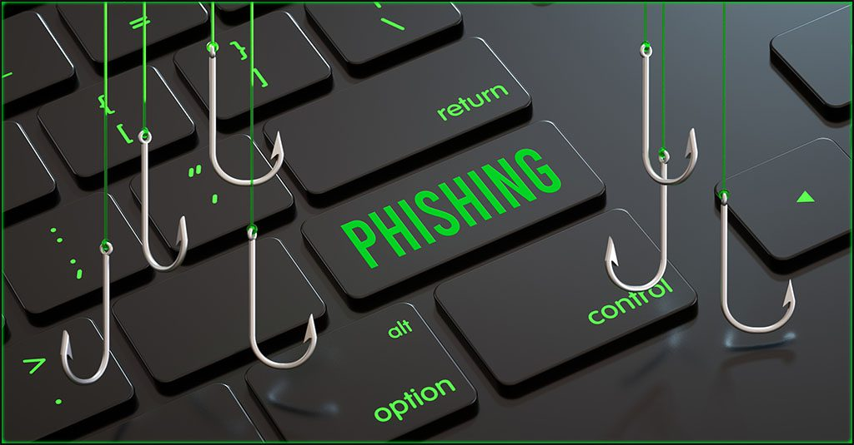
Definition of Phishing
01
02
03
Fraudulent attempt
Malicious emails/websites
Social engineering tactic
Tricking users into revealing sensitive information.
Impersonating legitimate entities to steal data.
Exploiting human vulnerabilities to gain access.

Slide 5
Types of Phishing Attacks
Email Phishing
Spear Phishing
Smishing
Fraudulent emails impersonating legitimate organizations.
Targeted attacks on specific individuals or organizations.
Phishing attacks via text messages or SMS.

Slide 6
Phishing Techniques
Deceptive Emails
Fake Websites
Vishing and Smishing
Fraudulent emails that appear to be from legitimate sources to trick users.
Malicious websites designed to mimic trusted sites and steal user data.
Phone and SMS-based phishing attempts to obtain sensitive information.

Slide 7
Identifying Phishing Attacks
02

Slide 8
Warning Signs of Phishing
01
Suspicious Sender
02
Urgent Requests
03
Inconsistent Details
Unfamiliar or unusual email address or domain.
Demands for immediate action or personal information.
Mismatched URLs, logos, or branding.

Slide 9
Evaluating Email and Website Legitimacy
Inspect Email Headers
Examine Website URLs
Verify Digital Certificates
Analyze email headers to detect spoofed sender addresses.
Identify suspicious domain names and URLs.
Confirm website SSL/TLS certificates are valid.

Slide 10
Verifying Sender Identity
Examine Email Address
Check for misspellings or unusual domain names.
Scrutinize Sender Details
Confirm the sender's identity matches the email address.
Validate Digital Signatures
Ensure the email's digital signature is authentic.

Slide 11
Protecting Against Phishing
03

Slide 12
Employee Training and Awareness
Identify Phishing Attempts
Implement Security Protocols
Conduct Regular Simulations
Educate employees on recognizing suspicious emails, links, and requests.
Establish procedures for reporting and responding to potential phishing incidents.
Test employee preparedness through phishing simulation exercises.

Slide 13
Technical Safeguards
Implement Email Filtering
Detect and block suspicious emails.
Enable Multi-Factor Authentication
Secure accounts with additional verification.
Update Software Regularly
Patch vulnerabilities to prevent exploits.

Slide 14
Incident Response Planning
Identify Phishing Threats
Establish Incident Response Protocols
Train Employees on Phishing Awareness
Recognize common phishing tactics and indicators.
Outline steps to contain, investigate, and mitigate phishing attacks.
Educate staff to identify and report suspicious emails.

Slide 15
Impact of Phishing Attacks
04

Slide 16
Financial Losses
Significant monetary damages
Phishing attacks can lead to substantial financial losses through theft of funds, identity theft, and fraudulent transactions.
Disruption of business operations
Phishing incidents can disrupt normal business activities, resulting in productivity losses and increased operational costs.

Slide 17

Financial Losses
Reputational damage
Successful phishing attacks can severely harm an organization's reputation, leading to loss of customer trust and potential legal liabilities.

Slide 18
Reputational Damage
Tarnished brand image
Phishing attacks can severely damage a company's reputation, leading to loss of customer trust.
Financial losses
Phishing attacks can result in significant financial losses due to fraud and theft.
Legal and regulatory issues
Phishing attacks may lead to legal and regulatory consequences for the affected organization.

Slide 19
Data Breaches
Sensitive Data Exposure
Financial Losses
Phishing attacks can lead to the theft of sensitive personal or financial information.
Victims of phishing attacks may suffer direct monetary losses through fraudulent transactions.

Slide 20
Data Breaches
Reputational Damage
Organizations hit by phishing-related data breaches can face significant reputational harm.

Slide 21
Phishing Trends and Statistics
05

Slide 22
Increase in Phishing Attacks
01
Phishing attacks on the rise
Phishing attacks have seen a significant increase in recent years, with more individuals and organizations being targeted.
02
Sophisticated phishing tactics
Cybercriminals are using more advanced techniques to make their phishing attempts more convincing and successful.

Slide 23
Increase in Phishing Attacks
Targeted industries
Certain industries, such as finance and healthcare, are disproportionately affected by phishing attacks.

Slide 24
Targeted Industries
Financial Services
Healthcare
Retail
Phishing attacks often target financial institutions and their customers.
Healthcare organizations are vulnerable due to sensitive patient data.
Retail companies are targeted for customer payment information.

Slide 25
Evolving Phishing Tactics
Increased Personalization
Phishers leverage personal data to craft more convincing lures.
Expanded Attack Vectors
Phishing extends beyond email to social media, messaging apps, and SMS.
Sophisticated Techniques
Phishers use AI-generated content and deepfakes to bypass detection.

Slide 26
Reporting and Responding to Phishing
06

Slide 27
Reporting to Authorities
Notify Relevant Agencies
Provide Detailed Information
Cooperate with Investigations
Report phishing attempts to law enforcement and cybersecurity authorities.
Share specifics about the phishing attack, including email, website, and any compromised data.
Assist authorities in their efforts to track and mitigate the phishing threat.

Slide 28
Mitigating the Impact
01
Identify Phishing Attempts
02
Respond Promptly
03
Implement Security Measures
Educate employees to recognize phishing indicators.
Report suspected phishing incidents to IT team.
Deploy anti-phishing tools to detect and block attacks.

Slide 29
Preventing Future Attacks
Identify Vulnerabilities
Implement Security Measures
Establish Incident Response
Analyze past phishing attempts to uncover system weaknesses.
Deploy anti-phishing tools and educate employees on best practices.
Develop a plan to quickly detect, investigate, and mitigate phishing incidents.

Slide 30
Thank You
Mariana ElMasry

